Slide 1



Ironhack
Capstone Project
Vehicle Fleet Preventative Maintenance

Slide 2
On a per-vehicle level, connectivity could deliver up to $310 in revenue and $180 in cost savings per year, on average, in 2030.

Slide 3
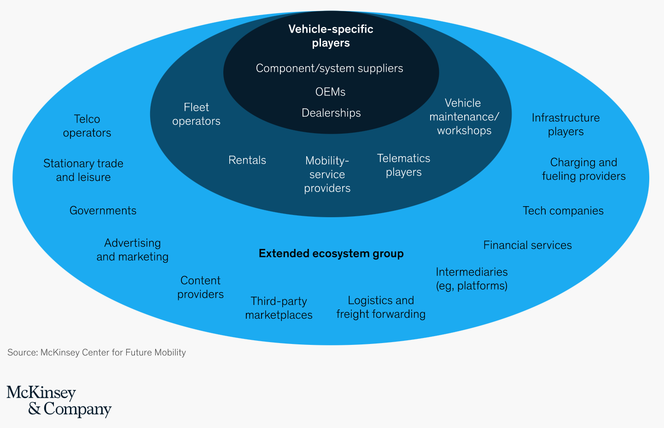

Slide 4
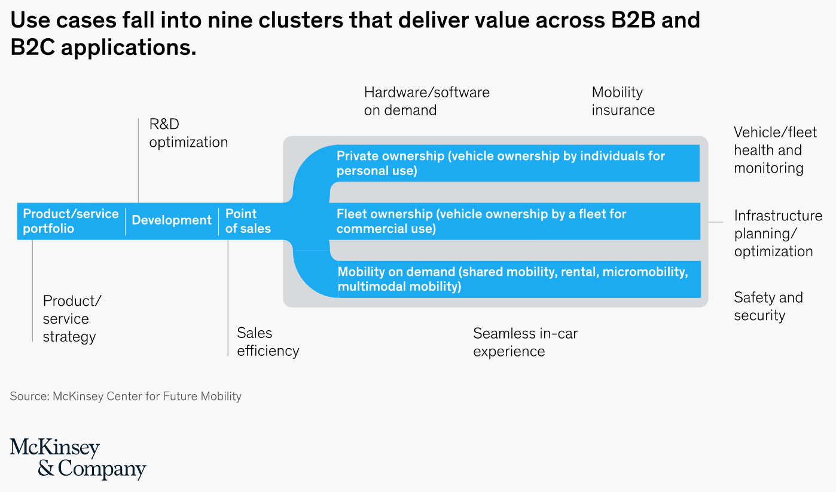

Slide 5
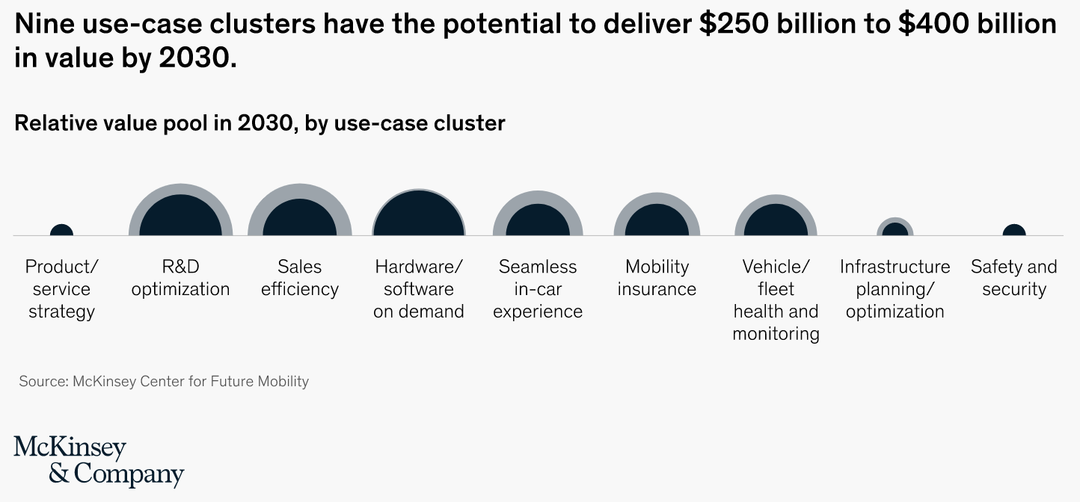

Slide 6

Where is the market moving?
Ironhack
Capstone Project
CONFIDENTIAL

Slide 7
Predictive Maintenance Market
28% CAGR
(2019 – 2027)
USD $ 19.4 Bn. 2020
USD $ 73.6 Bn. 2027

Slide 8
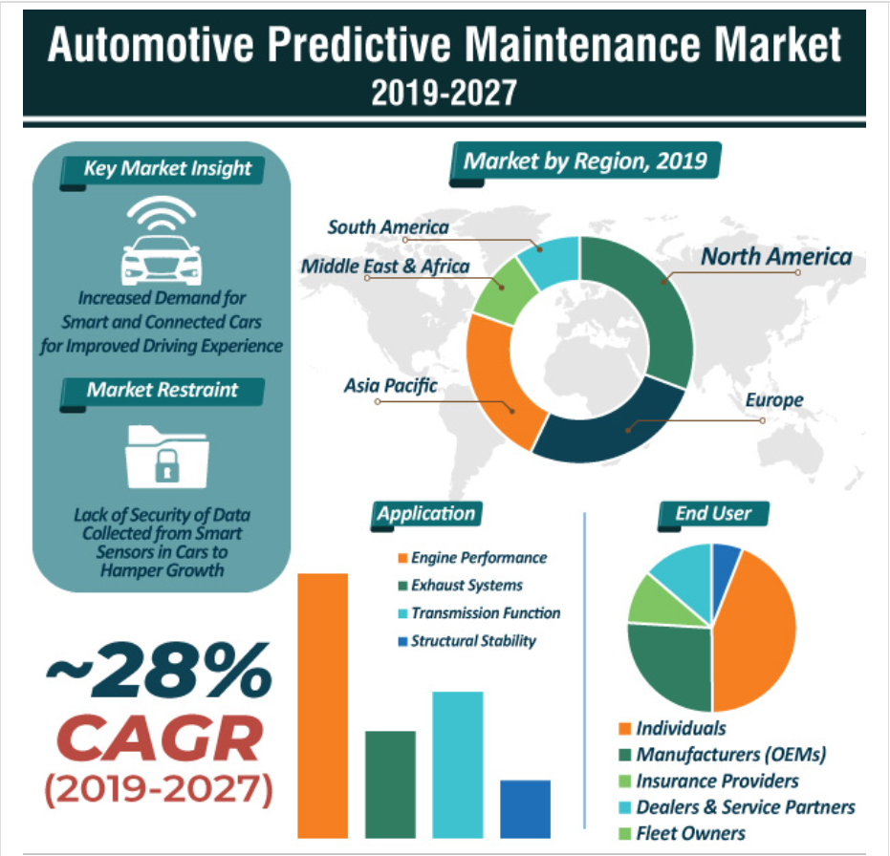
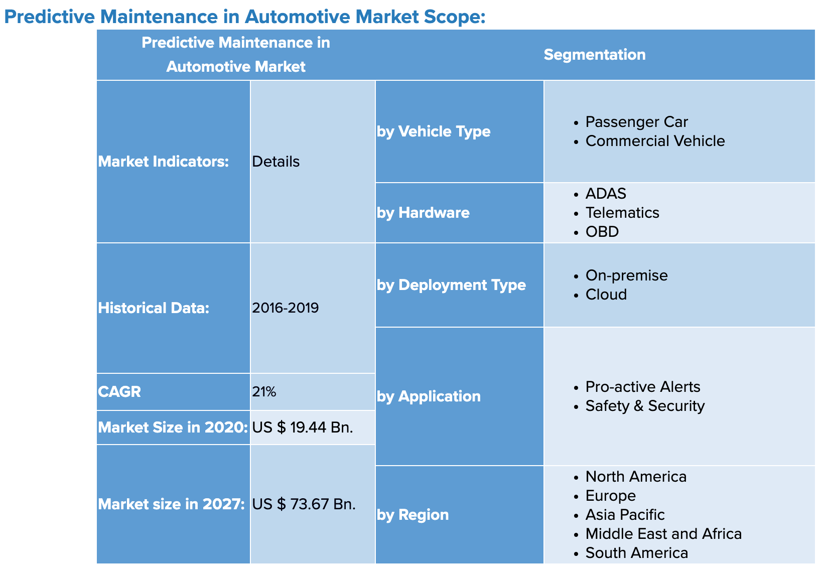
Predictive Maintenance Market
28% CAGR
(2019 – 2027)

Slide 9
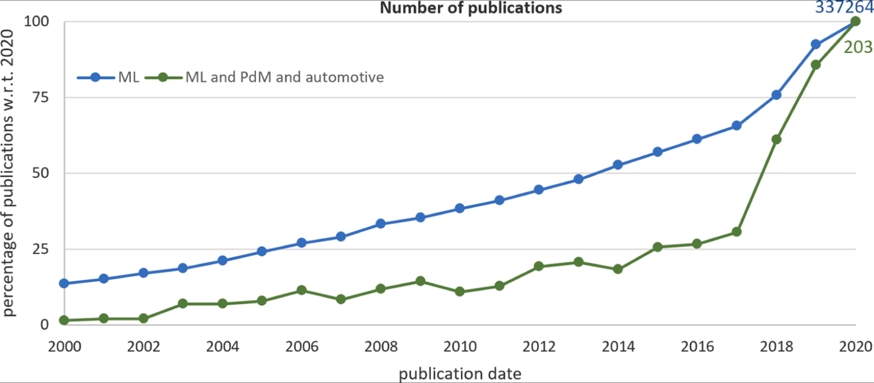
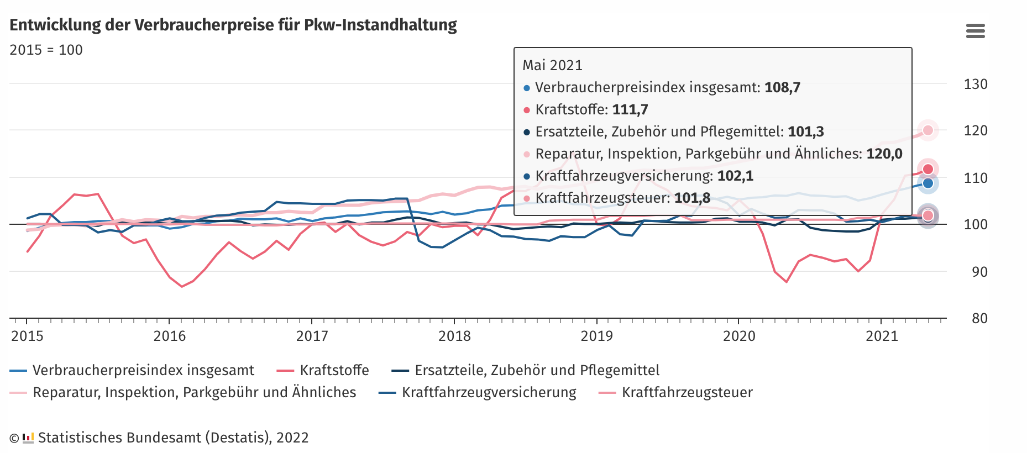
Hype?
Hype? Increasing Cost Pressure for Consumers

Slide 10
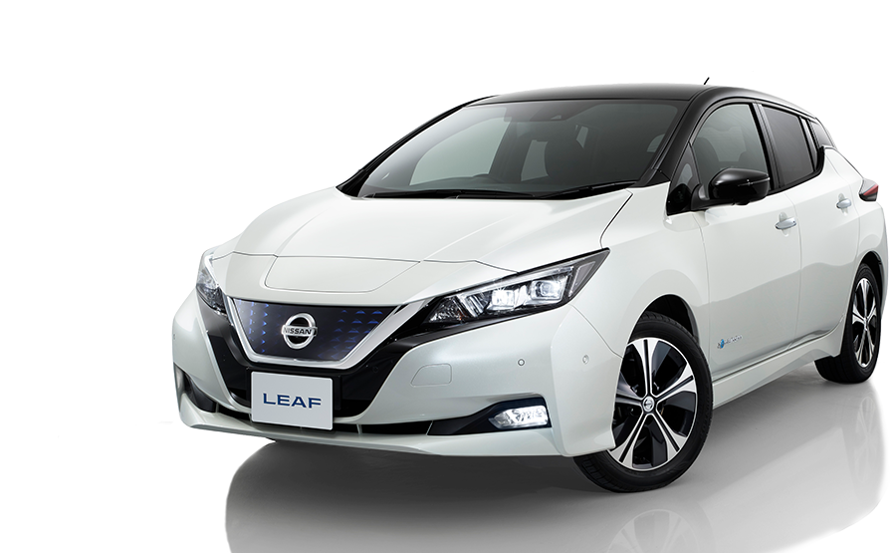

Electrical Vehicles will triple in EU in next 3 years

Slide 11
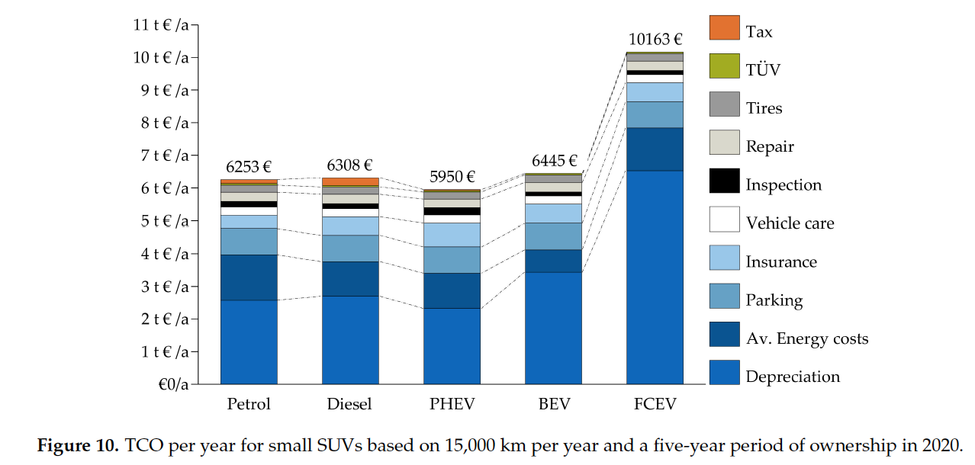
Total Cost of Ownership

Slide 12
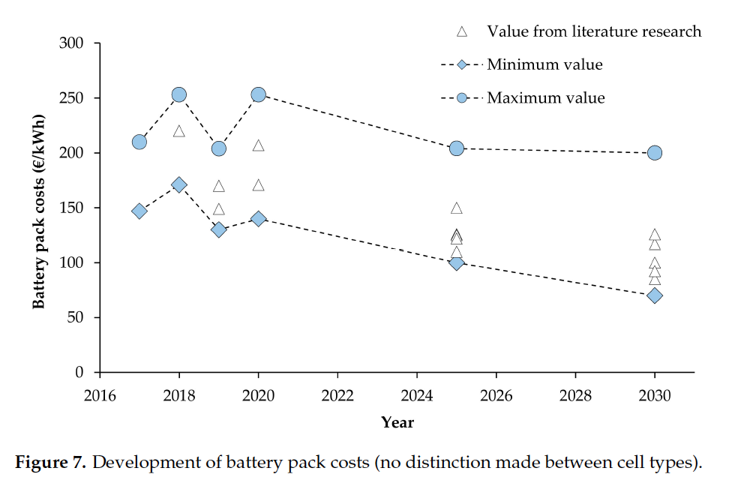
Vehicle downtime cost range between $488 to $760 on average

Slide 13
PdM product solution I – ICE’s
Ironhack
Capstone Project
CONFIDENTIAL

Slide 14
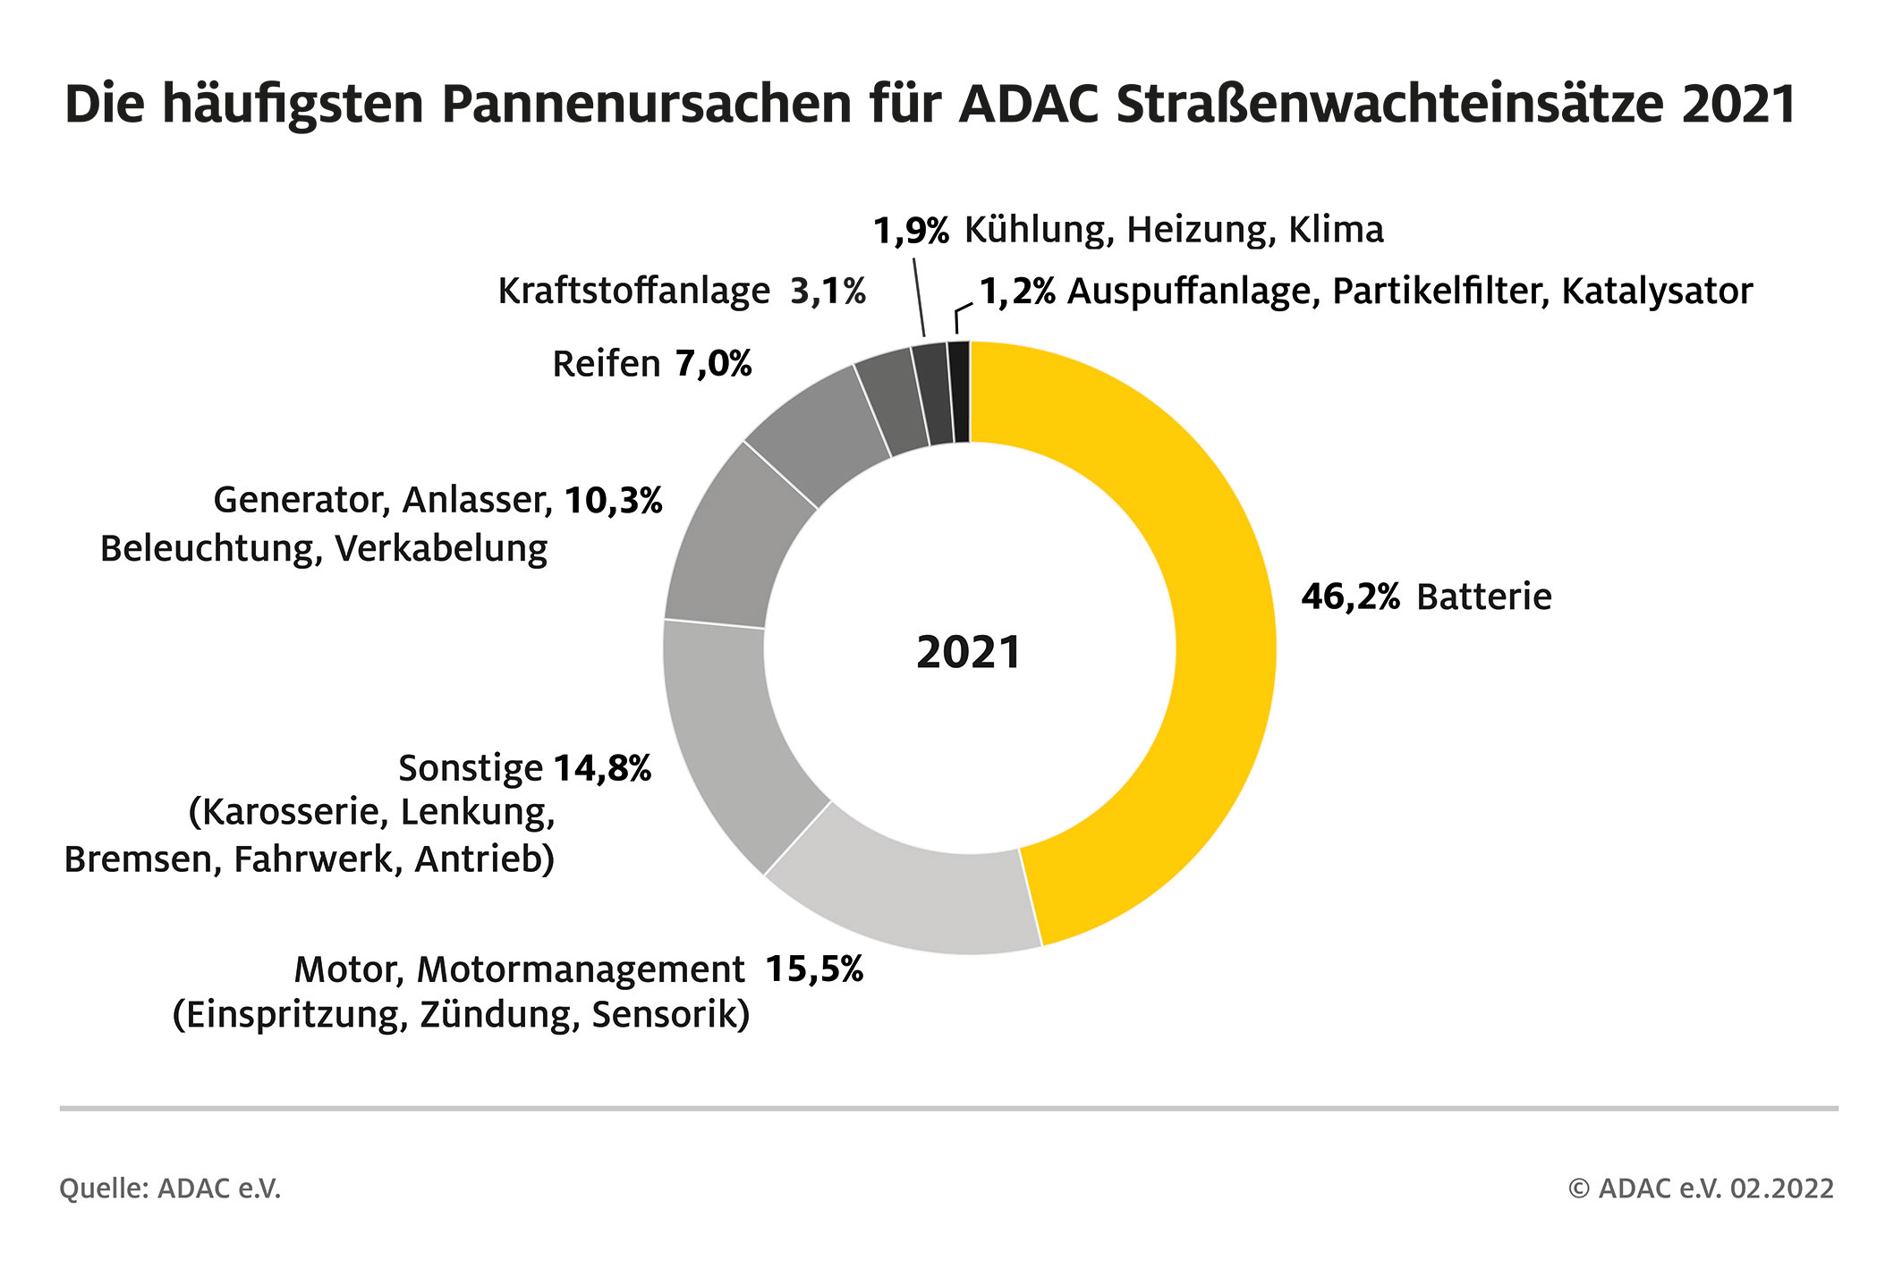
Smart product need

Slide 15

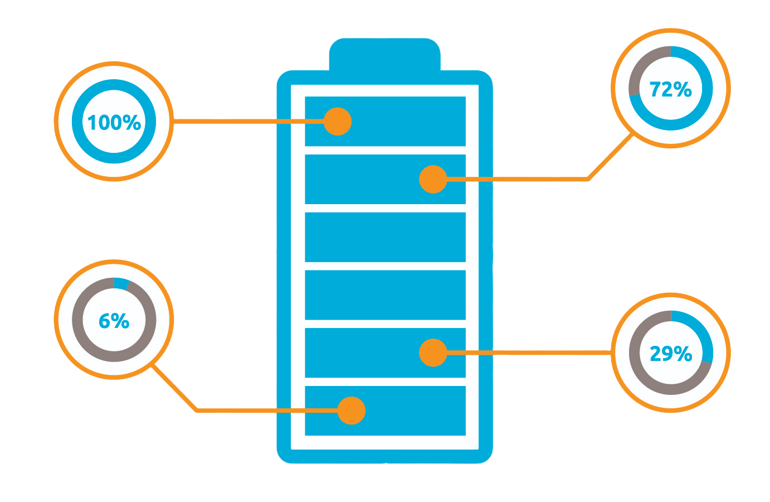
Smart product solution
The smart product solution is a deployable reference architecture demonstrating the “art of the possible” and enabling vehicle fleet owners, dealerships and OEM manufactures to jump-start development of innovative smart product services.
Default devices: vehicle battery (voltage, current, SoC, outside temperature)
- Visit my Vehicle Fleet PdM repo:
https://github.com/Gunnar-D2810/Preventative-Maintenance-Fleet-Management

Slide 16
Introduction to preventative maintenance for ICE batteries
Ironhack
Capstone Project
CONFIDENTIAL

Slide 17
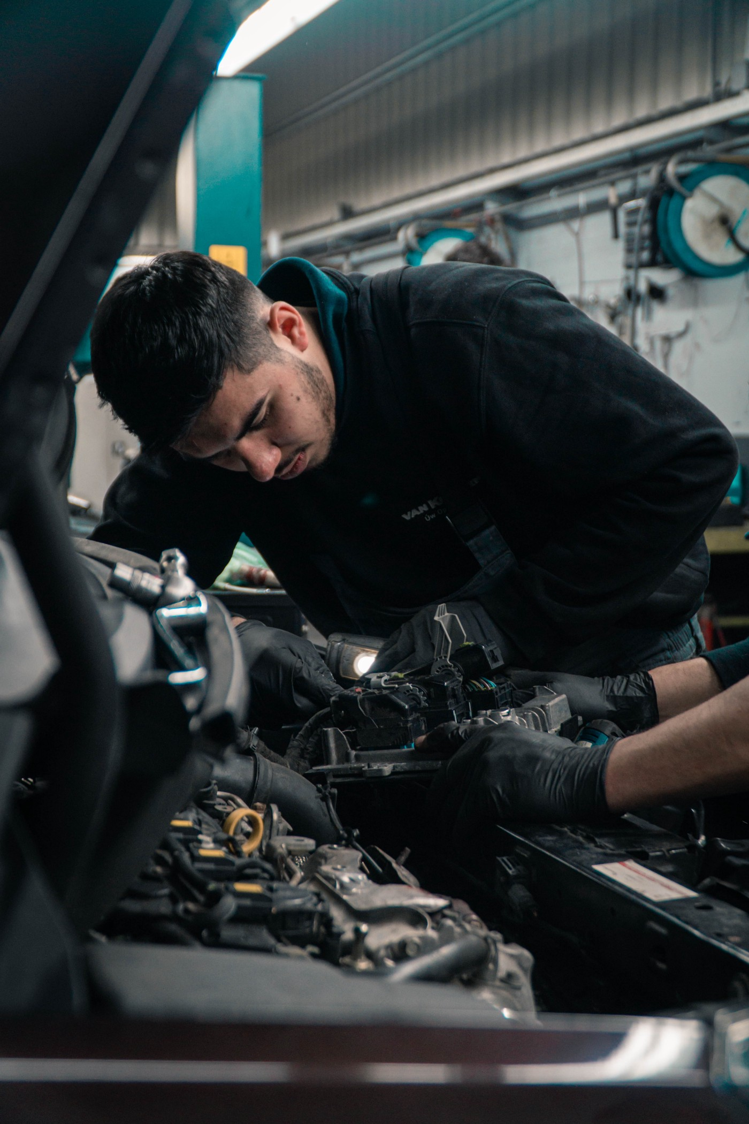
Maintenance: Corrective versus preventative
Oil change
Changing a flat tire
Changing tires on a stock car
Replacing old suspension

Slide 18





Predictive maintenance in principle
Date | VIN | ECU code | Cause
1/22/2 017 | 1234 | P0302 | Spark plug
2/4/20 16 | 5678 | U0102 | Wiring
2/2/20 17 | 9012 | C0701 | Low coolant
2/29/2 018 | 3456 | P1501 | Speed sensor
spark plug
wiring
low
coolant
speed sensor

Slide 19
Design decisions of
smart ICE product solutions
Ironhack
Capstone Project
CONFIDENTIAL

Slide 20

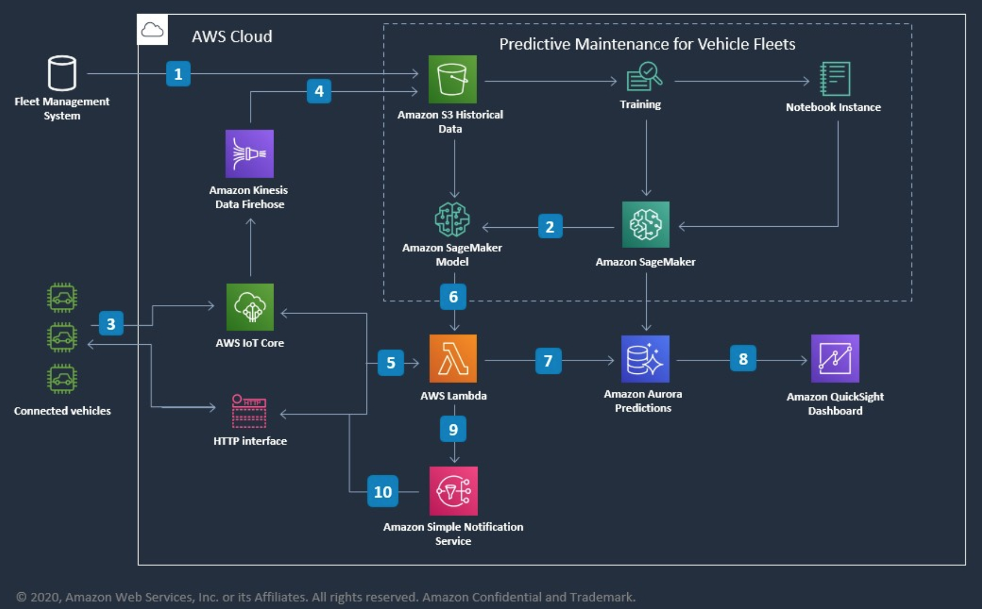
Smart product solution architecture ICE battery

Slide 21


Smart product processing ICE battery
PyTorch DNN classification model
predicting battery failure.
OEM Schedules
Dynamic Telemetry
Data

Slide 22
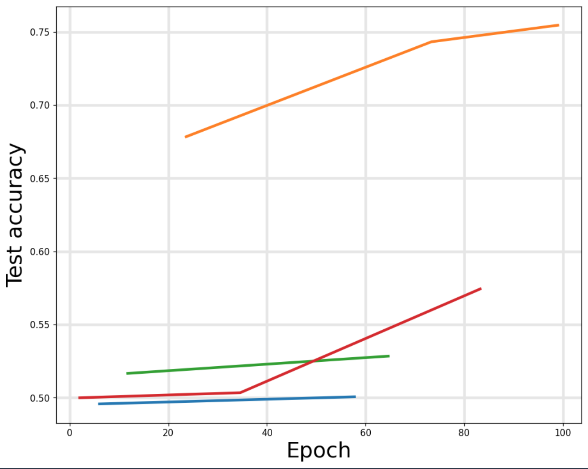
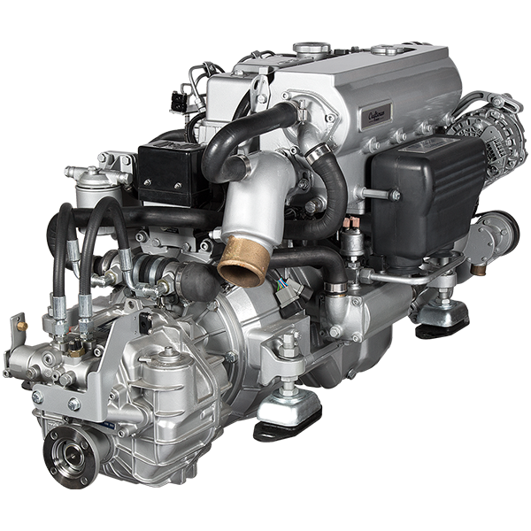
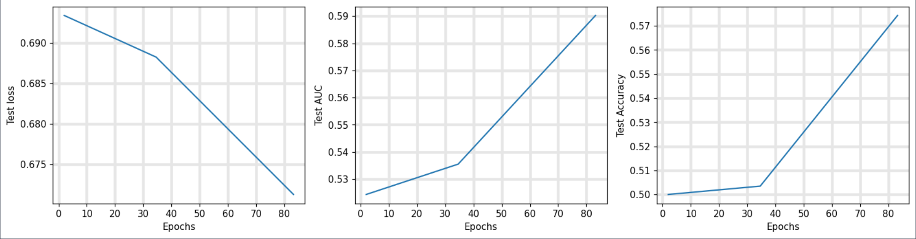
Model performance ICE battery
Given the sample input data,
the predicted probability of failure
is 46.92%
Skoda Octavia
Internal combustion engine (Diesel)

Slide 23
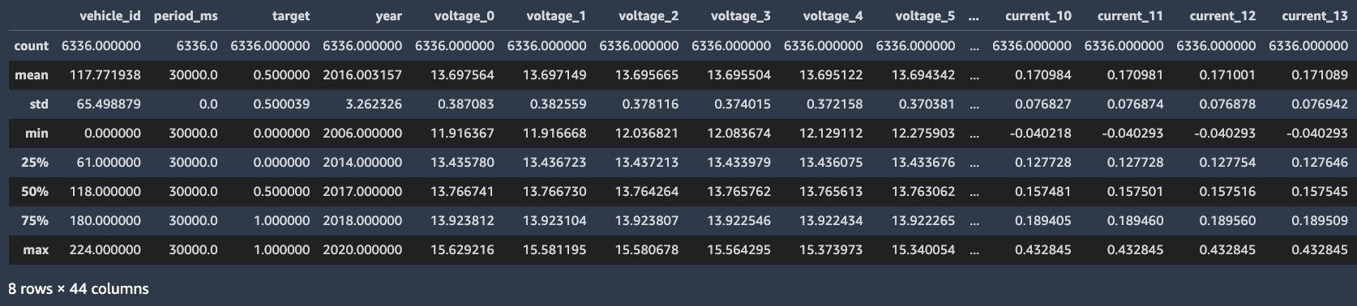

Predictive maintenance ICE battery interpretation
Battery telemetric data
Given the sample input data,
the predicted probability
of failure is 46.92%
OEM Maintenance data
Example: Maintenance planned in 12 month

Slide 24
PdM product solution I – BEV’s
Ironhack
Capstone Project
CONFIDENTIAL

Slide 25
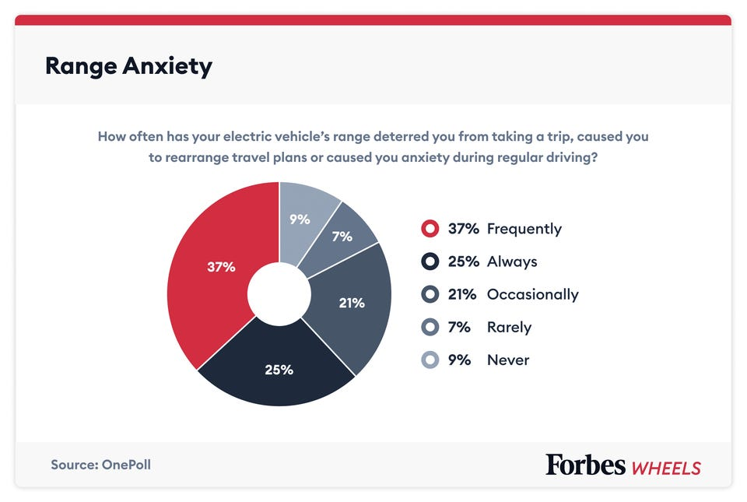
Smart product need

Slide 26
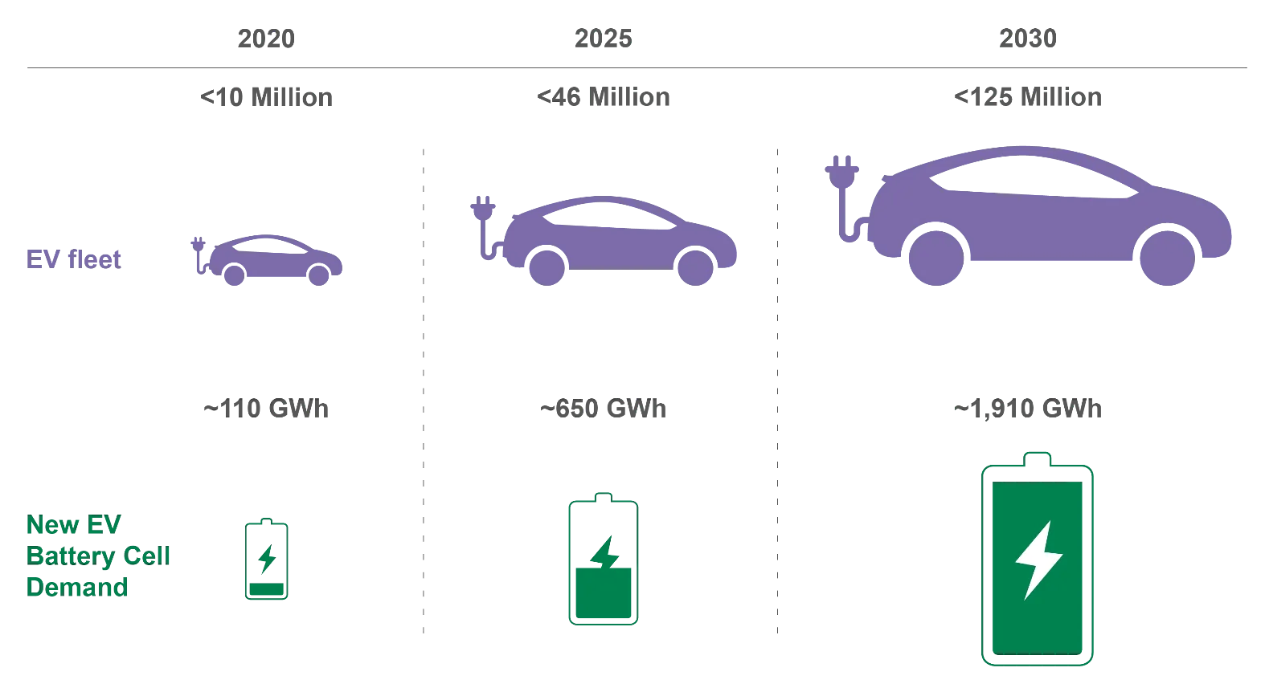
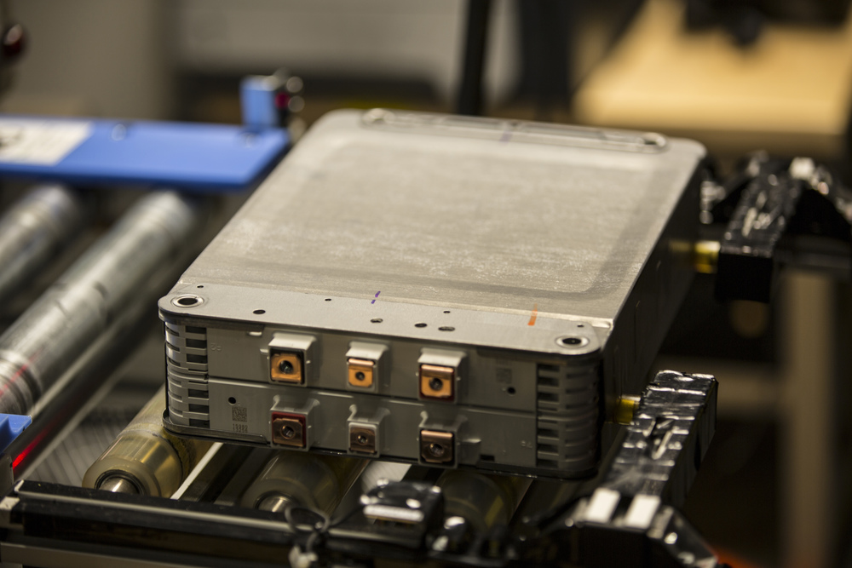
Smart product solution
Please find battery training data here
www.batteryarchive.org
The smart product solution is a deployable reference architecture demonstrating the “art of the possible” and enabling vehicle fleet owners, dealerships and OEM manufactures to jump-start development of innovative smart product services.
Default devices: Electrical vehicle battery pack (voltage, current, SoC, outside temperature).
- Visit my Vehicle Fleet PdM repo:
https://github.com/Gunnar-D2810/Preventative-Maintenance-Fleet-Management

Slide 27
Introduction to preventative maintenance for EV battery drive
Ironhack
Capstone Project
CONFIDENTIAL

Slide 28
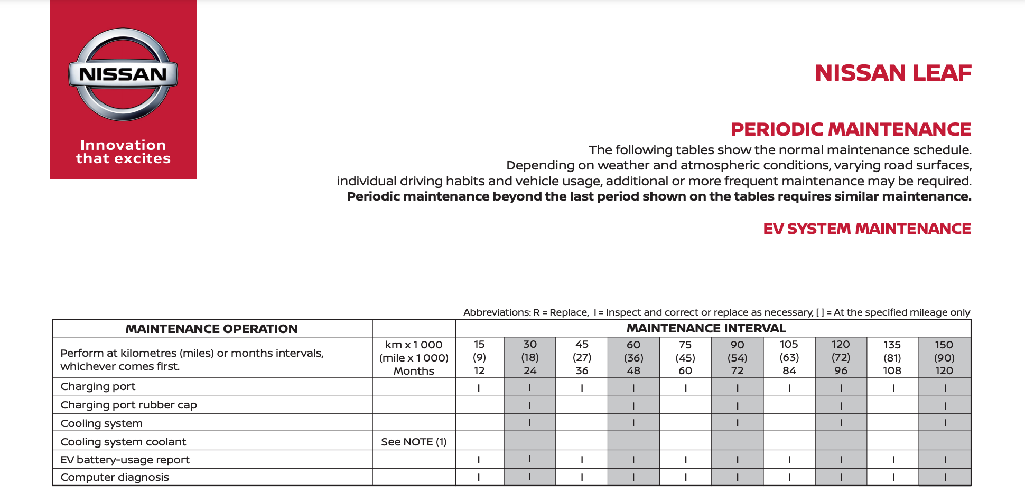
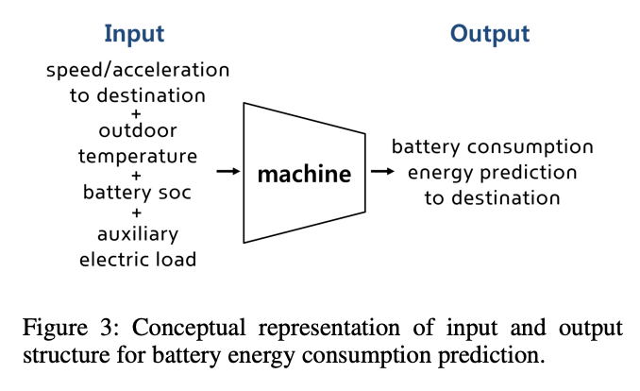
Maintenance: Corrective versus preventative
Corrective
Preventative

Slide 29
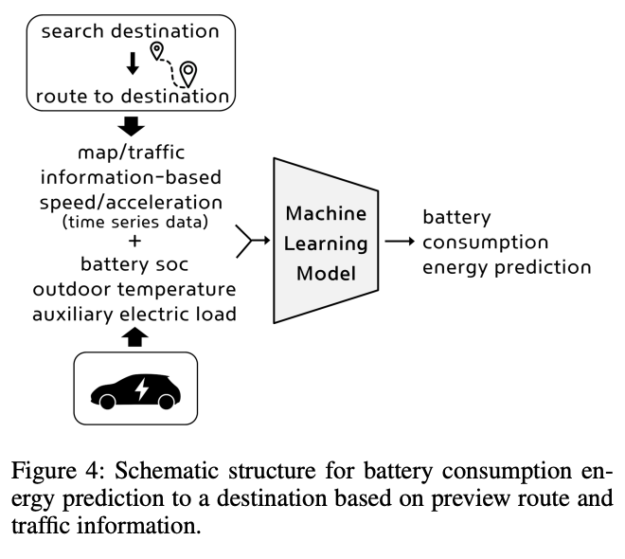
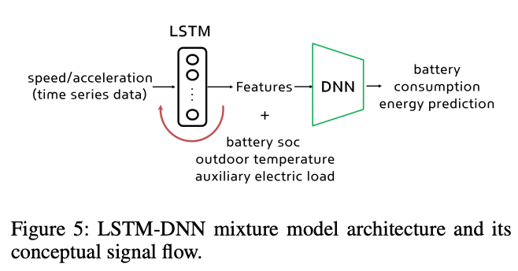
Predictive maintenance in principle
Kim, D., Shim, H. G., & Eo, J. S. (2022). A Machine Learning Method for EV Range Prediction with Updates on Route Information and Traffic Conditions. Proceedings of the AAAI Conference on Artificial Intelligence, 36(11), 12545-12551. https://doi.org/10.1609/aaai.v36i11.21525
spark plug
wiring
low
coolant
speed sensor
OEM Maintenance data
Predict maintenance date with LSTM-DNN and
optimize against OEM by max. uptime.

Slide 30
Design decisions of
smart EV product solutions
Ironhack
Capstone Project
CONFIDENTIAL

Slide 31
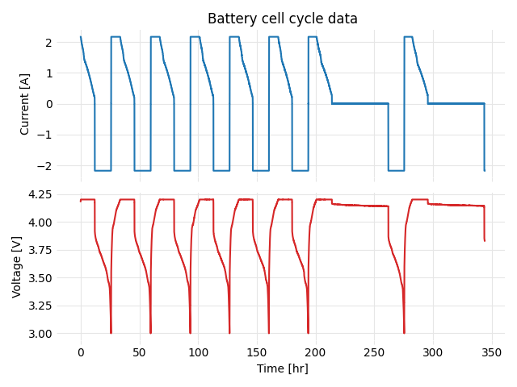
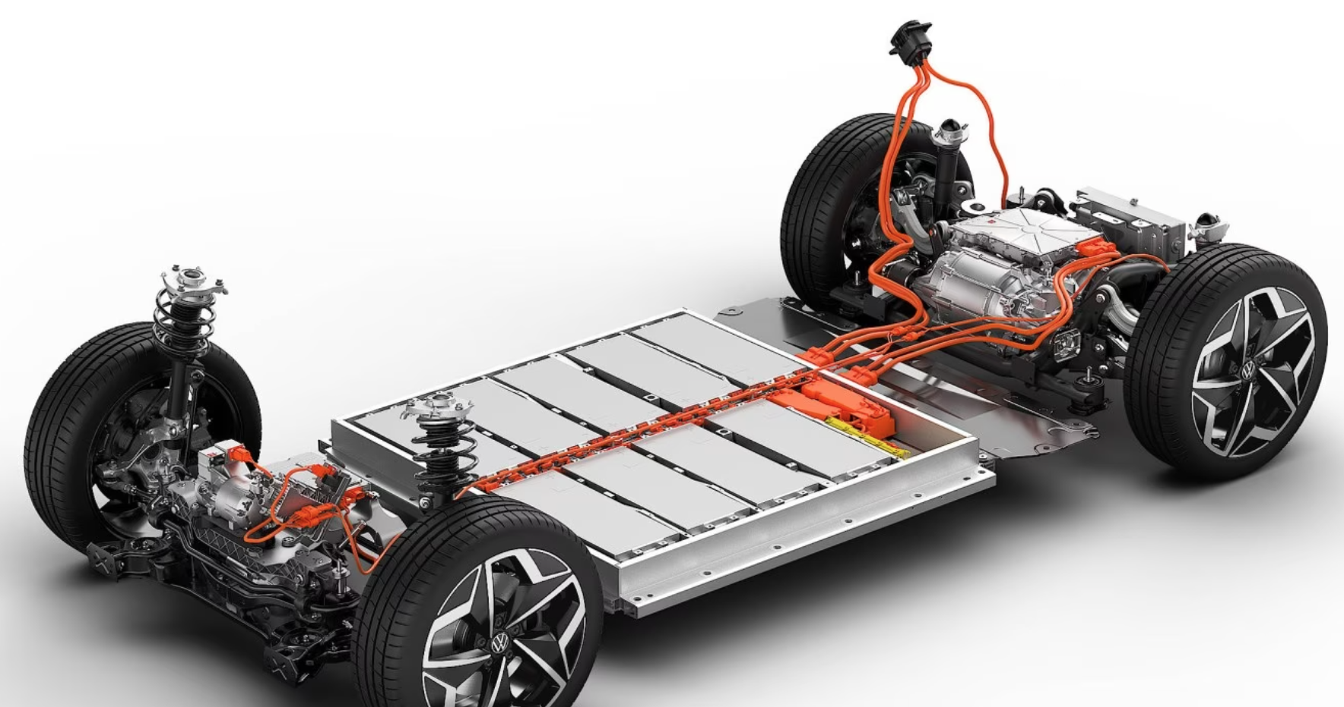
Descriptive performance EV battery Nissan Leaf
Nissan Leaf LiMn2O4 with LiNiO2 Battery Pack
Nissan Leaf
Electrical Car
Gavin Wiggins, Srikanth Allu, and Hsin Wang. Battery cell data from a 2013 Nissan Leaf. Oak Ridge National Laboratory. https://doi.org/10.5281/zenodo.2580327.
Collect spatial and temporal time series telemetry data for Nissan Leaf model
Use Wiggins et al. Nissan Leaf 2013 experimental data

Slide 32
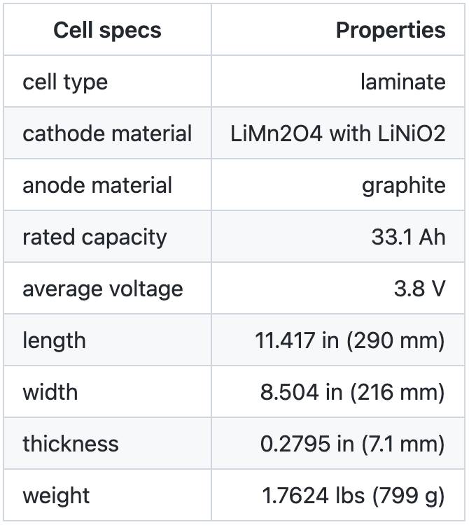
Descriptive EV battery Nissan Leaf 2013

Slide 33
Wrap Up
Ironhack
Capstone Project
CONFIDENTIAL

Slide 34


Contact
Gunnar David
Candidate: Senior Manager Data Science and Analytics
Experience: 7+ years
Contact
Work Email: gunnar.david@tuhh.de
Work Phone: +49 1575 08 277 31
Ironhack
Capstone Project
CONFIDENTIAL

Slide 35

Thank you!
Gunnar David
gunnar.david@tuhh.de
Ironhack
Capstone Project
CONFIDENTIAL

